Slide 1
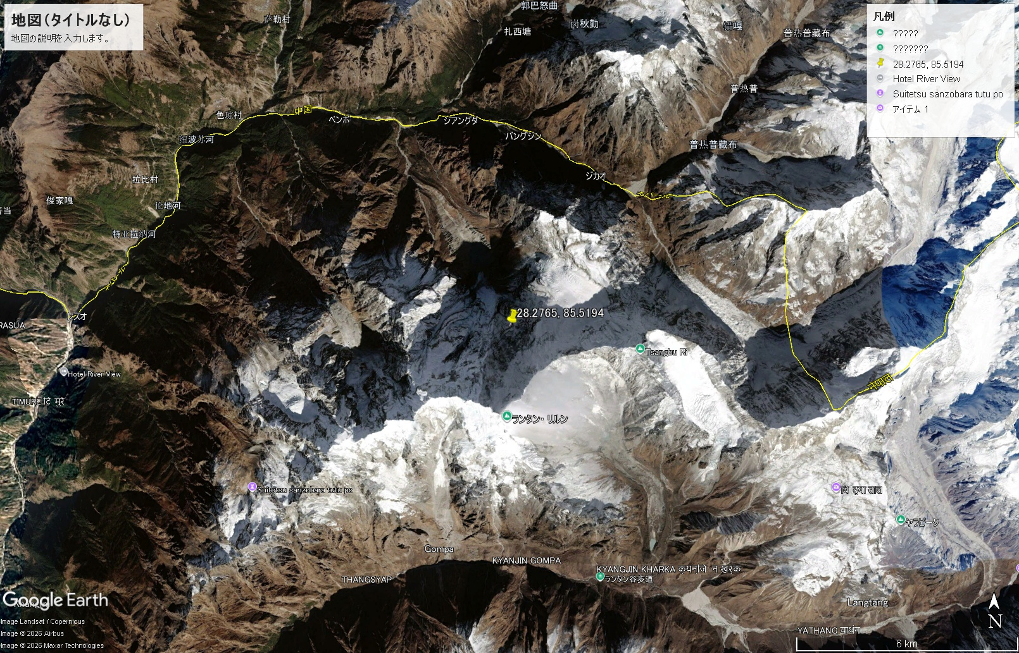
Langtan R.
Origin of debris flow

